Slide 1

PMO WEBAPP DEVELOPMENT
ASHU GUPTA (PROJECT MANAGER)
SIMRANJIT SINGH (PCO)
MANVI GUPTA (Team Lead)
MANSI GUPTA (Developer)
KIRAN (Tester)

Slide 2
AGENDA
Context and Objectives
Constraints And Assumptions
In Scope/Out Scope
Potential Benefits
WBS
PBS
Gantt Chart
Roles and Responsibilities
Procurement Management
Risk Management Plan
Change Management Plan
Communication Management Plan

Slide 3
CONTEXT AND OBJECTIVE
Context:
There is a lack of methodology, in the company especially in the PMO department that have difficulties to monitor all projects and make sure that there all pass the gating system mandatory to the federal audits conducted on a monthly basis. After revision of the different products available in the market that simply provide status of the portfolio & project timelines, cost & resource, the PMO of ABC Tech decide to hire a Startup firm to create a Customized Web Application tool.
Objective:
To create a web application for ABC tech to monitor all the projects and to make sure that audits conducted should pass all the gating systems.
To decrease the onbording time by 20% of new Project Manager hire by the end of 2021 and Increase by 40% of the number of project that respect the timeline, Budget.
Increase Customer Satisfaction by 35% by the end of 2021.

Slide 4
CONSTRAINTS
Budget- 100000$
Time- 10weeks (including buffer)
Covid -19 issues may impact client activities.

Slide 5
ASSUMPTION
May hire external resource if needed
Time might increase, if the requirement changes by the client.
English will be the overall language used in the application.
The services provided by ABC tech are well defined.
Can use any technology to develop the application.
Licensing cost for any tool/platform is not included in the allocated budget.
This is standalone web application.

Slide 6
Potential Benefits
Centralised Platform access by all authorties and employees.
Response time would be quick to access.
Quick downloadlable reports.
VPN facility.
Improved project delivery timings resulting in better return in Investment plus profits for organisation.
Clearly defined time cost and resource.
This web Application is highly configurable and flexible to allow for usage in a wide variety of environment and processes.
Smart approach for adopting both methodologies.
Multiple projects, multiple people and location variance.
The ease of use of this application makes it an accessible tool for everyone in the workplace.
It is a simple, fast and scalable service application that just makes project management more manageable.
As the storage would be in cloud. There will be less load on local servers.

Slide 7
IN SCOPE
Training.
Support for the web app after going live (1 week).
Deployment of the app using cloud technology (AWS/Azure).
System security.
Methodology would be waterfall and Agile.
Reports: Portfolio, Project, Resource.
Remote login (VPN)

Slide 8
OUT SCOPE
Not for mobile apps (android/IOs).
No in house setup.

Slide 9
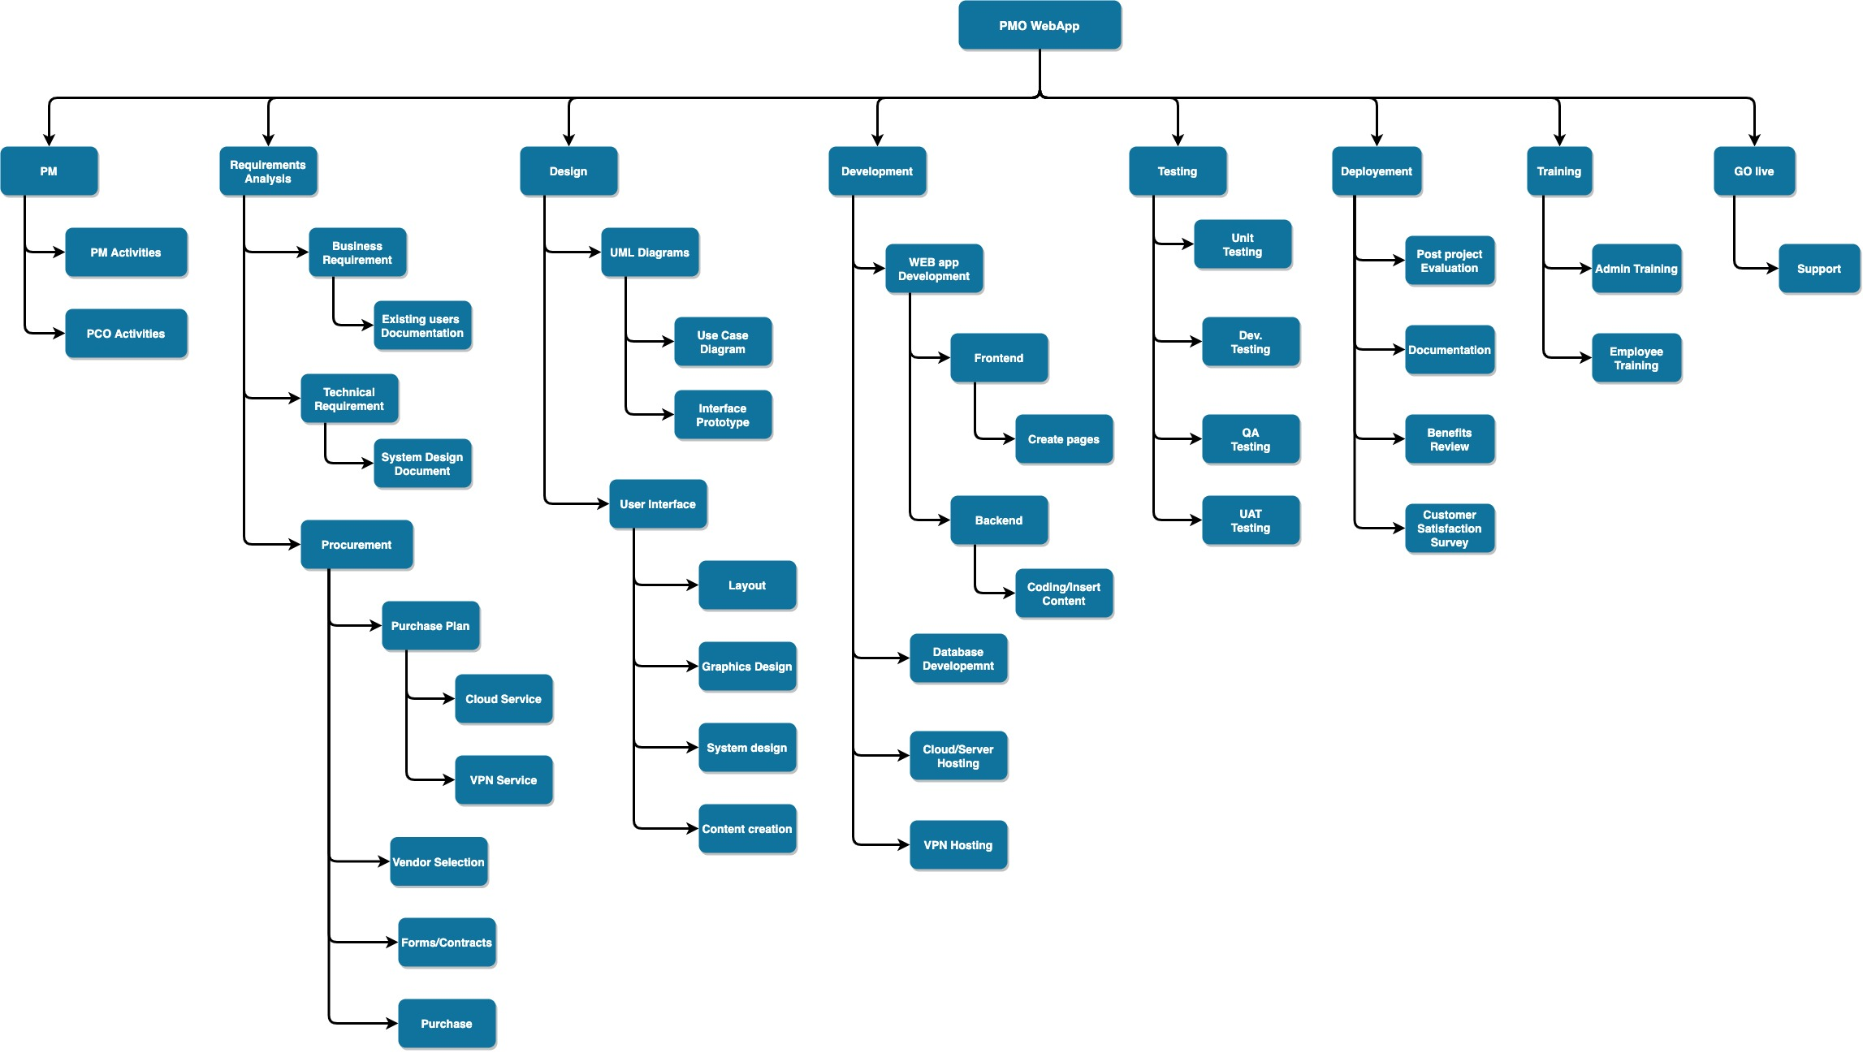
Work Breakdown Structure

Slide 10
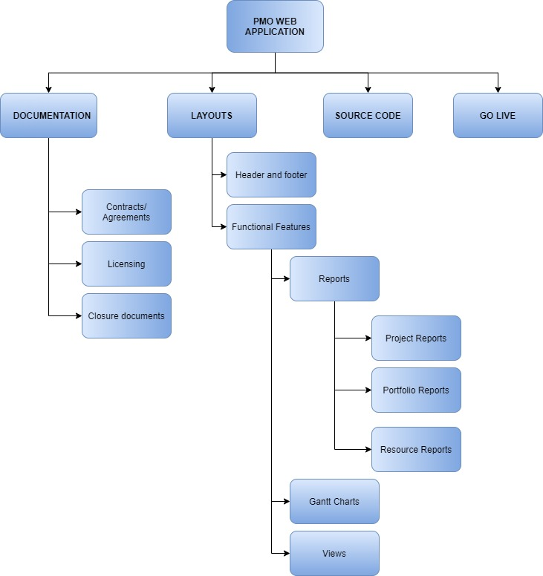
Product Breakdown Structure

Slide 11
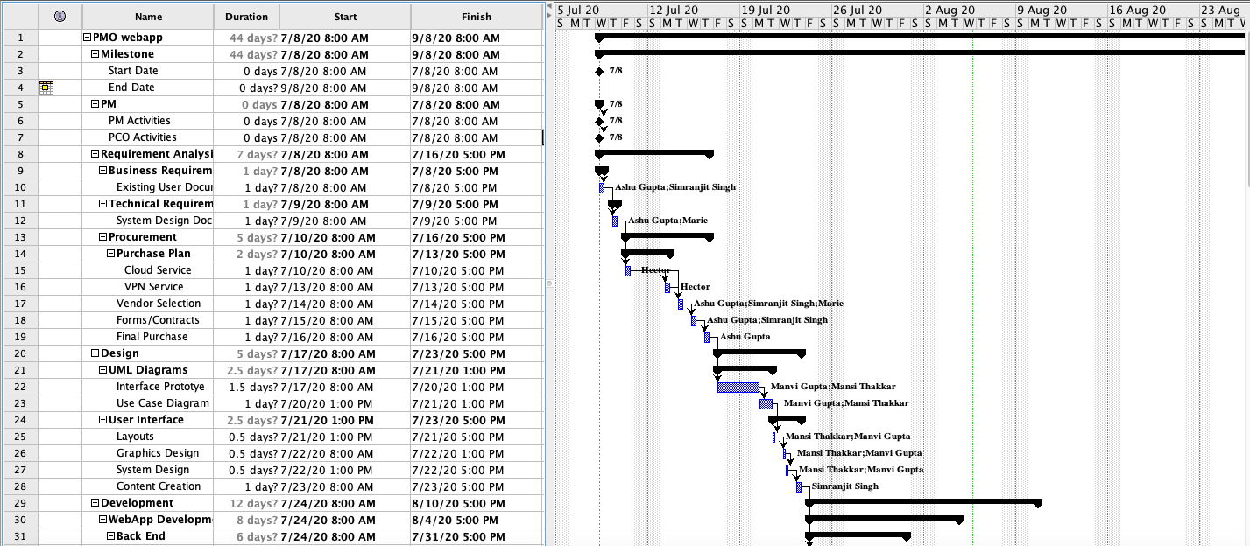
GANTT CHART

Slide 12
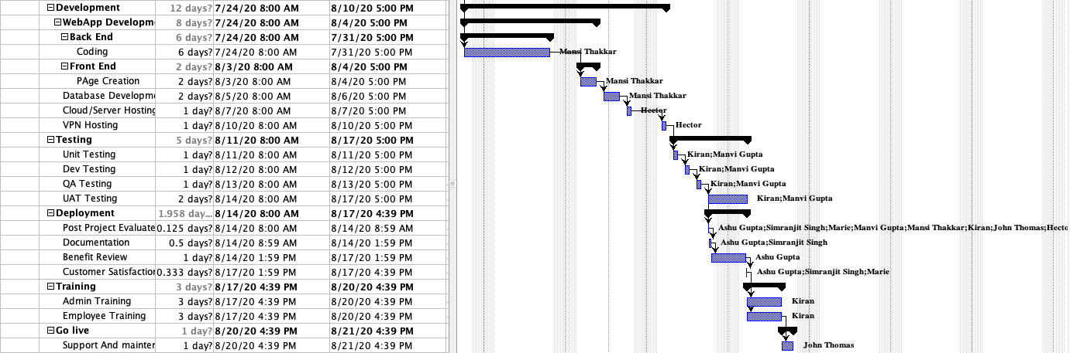
GANTT CHART

Slide 13
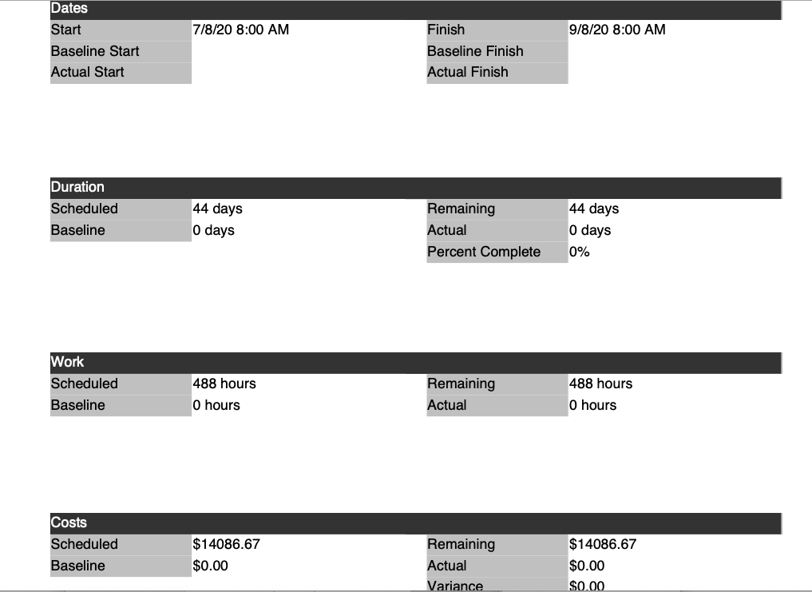
Resource Sheet

Slide 14
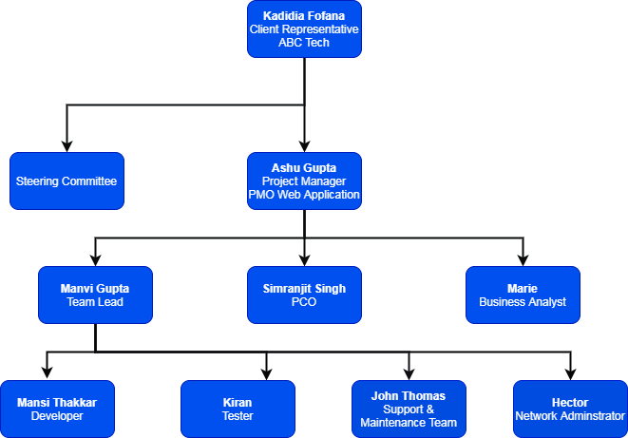
Roles and Responsibilities
Kadidia Fofana- Client
Ashu Gupta- Project manager
Simranjit Singh- PCO
Manvi Gupta- Team Lead
Marie- Business Analyst
Mansi Thakkar- Developer
Kiran- Tester
John Thomas- Support & Maintenance
Hector- Network Administrator

Slide 15
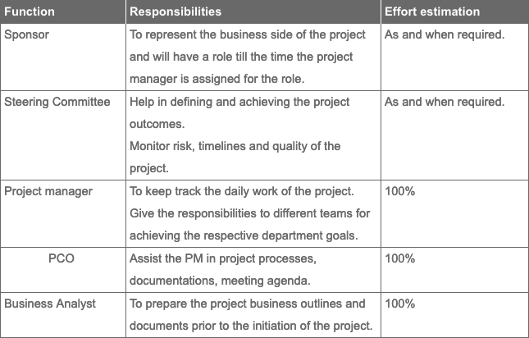
Roles and Responsibilities

Slide 16
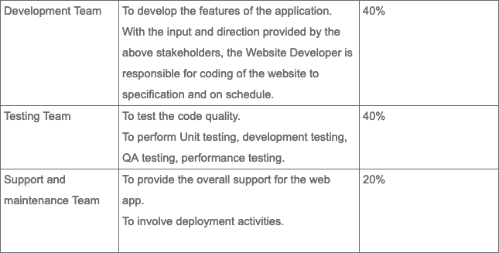
Roles and Responsibilities

Slide 17
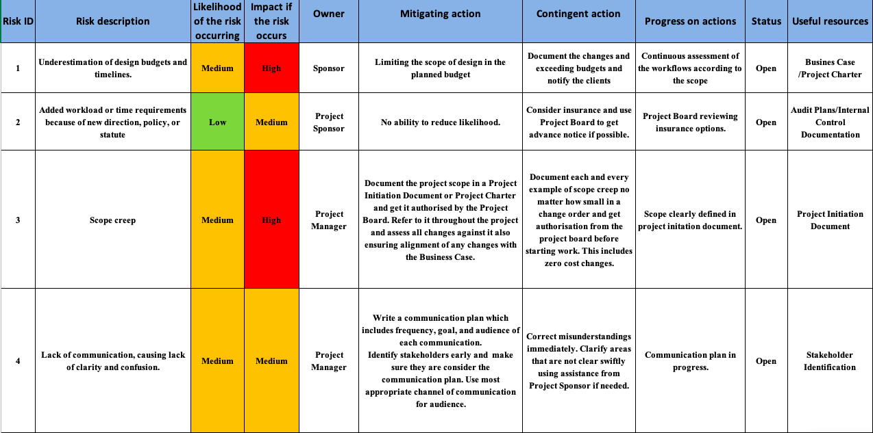
Risk Management Plan

Slide 18
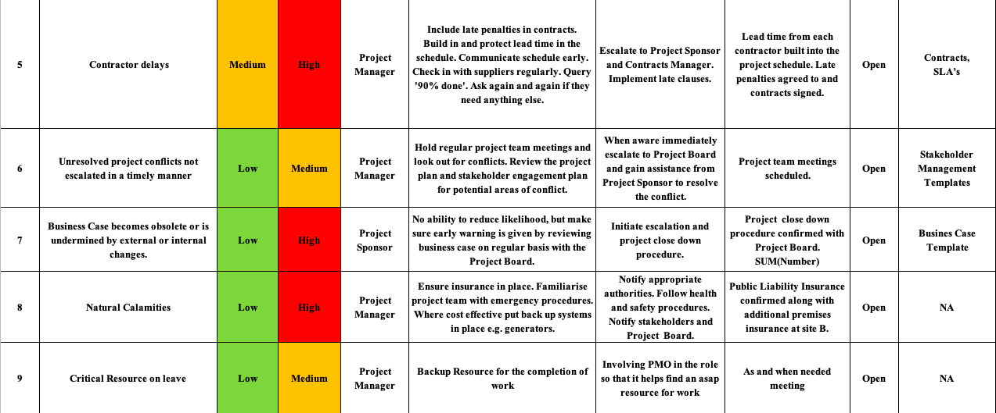
Risk Management Plan

Slide 19

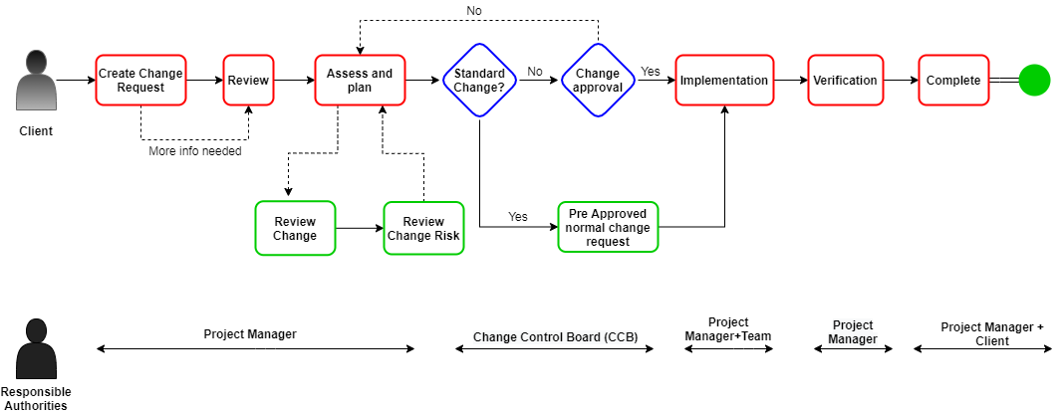
Change Management Process

Slide 20
Communication Management Plan
Communication Type | Objective of Communication | Medium | Frequency | Audience | Owner | Deliverable
Kickoff Meeting | Introduce the project team and the project. Review Project objective and management approves. | Video Conference with share screen (Microsoft team), Face to face | Once | Client Representative, Project Team, Stakeholders | Project Manager | Agenda and Meeting minutes
Stakeholder Meeting (Client) | Review Status of the project with the team | Video Conference with share screen (Microsoft team), Face to face | Weekly | Project Manager, PCO, Client, Stakeholders | Project Manger | Agenda, Meeting minutes and project Schedule
Internal Team Meeting | Review weekly status of the project with the team. Review Last week performance. | In person | Weekly, (Every Monday) | Respective Project Team | Project Manger | Agenda, Meeting minutes and project Schedule
Project Status Meeting | Updating the and giving opportunity to ask Questions | Audio Video Conference (Microsoft Team) | Bi-weekly | Client Representative, Project Team, Stakeholders | Project Manager, PCO | Agenda, Follow up for the Documents, Status update for project delivery
Design Review | Giving the project sponsor the opportunity to provide Feedback on the app designed | In person (If possible) or Video call, Email the design prior to the meeting | Once after initial design is complete | Client Representative, Project Manager, Designer | App Designer/ Project Manger | Prototype of the web Application.

Slide 21
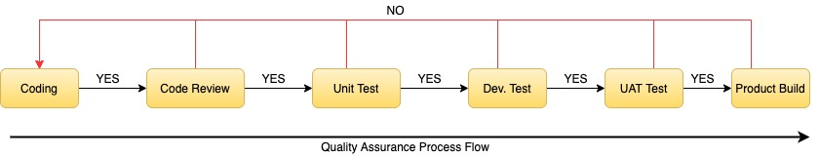
Quality Assurance Process Flow

Slide 22
Project Closure
Following are the steps for project closure phase:
Develop closure procedures.
Document final performance reporting.
Hand-off completed products, process or code.
Release resources.
Complete contract closures.
Key Output of this phase :
Receive all signs-off that work is completed as per requirments.
Index and archive all project aspects.
Create and document lesson learned.

